Slide 1
How to upload Assets into Innovation Theater
June 2019

Slide 2
Create Assets
Submit Assets
Asset Owner
Log into Innovation Theater
Mouse move over to the User Profile (Top right corner)
Click on My Assets and then click on Create Assets
Enter / update Asset Details
Click on Submit Button
If Rejected
AIE Board
Sent for Approval
If Approved
Innovation Theater
Publish on Portal

Slide 3
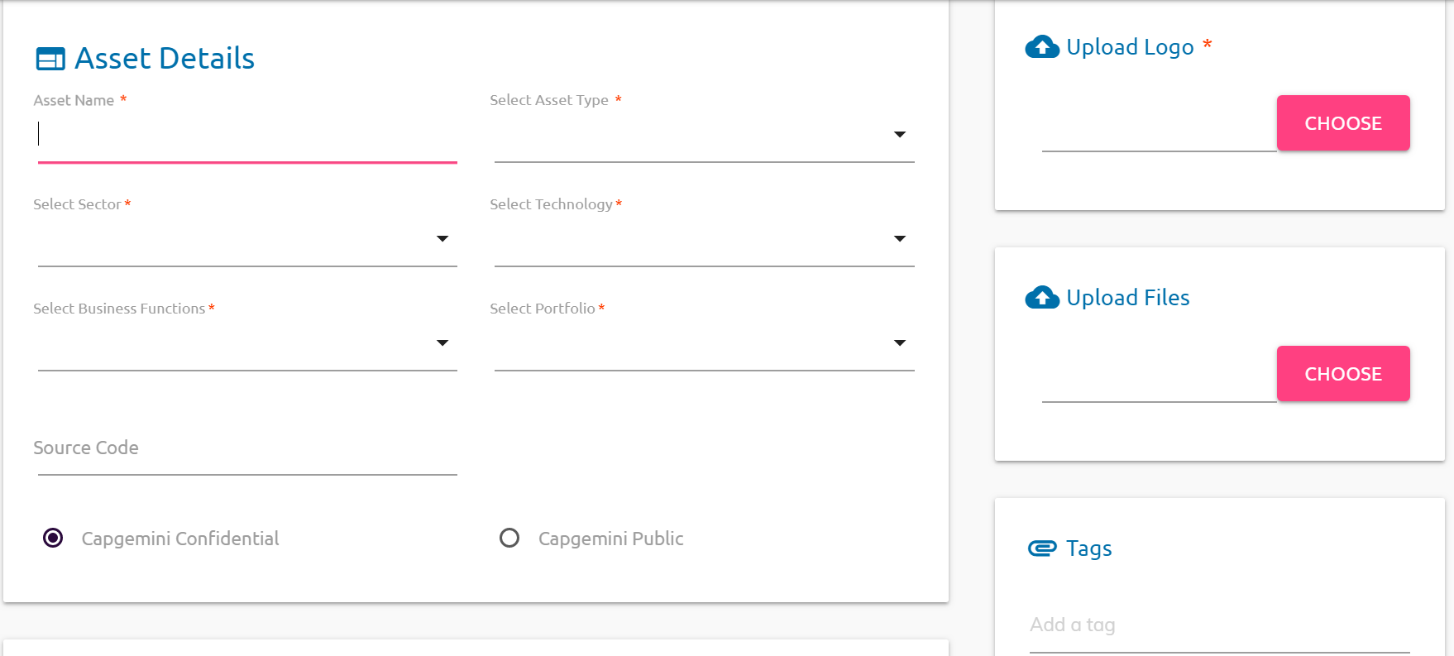
Assets Details

Slide 4
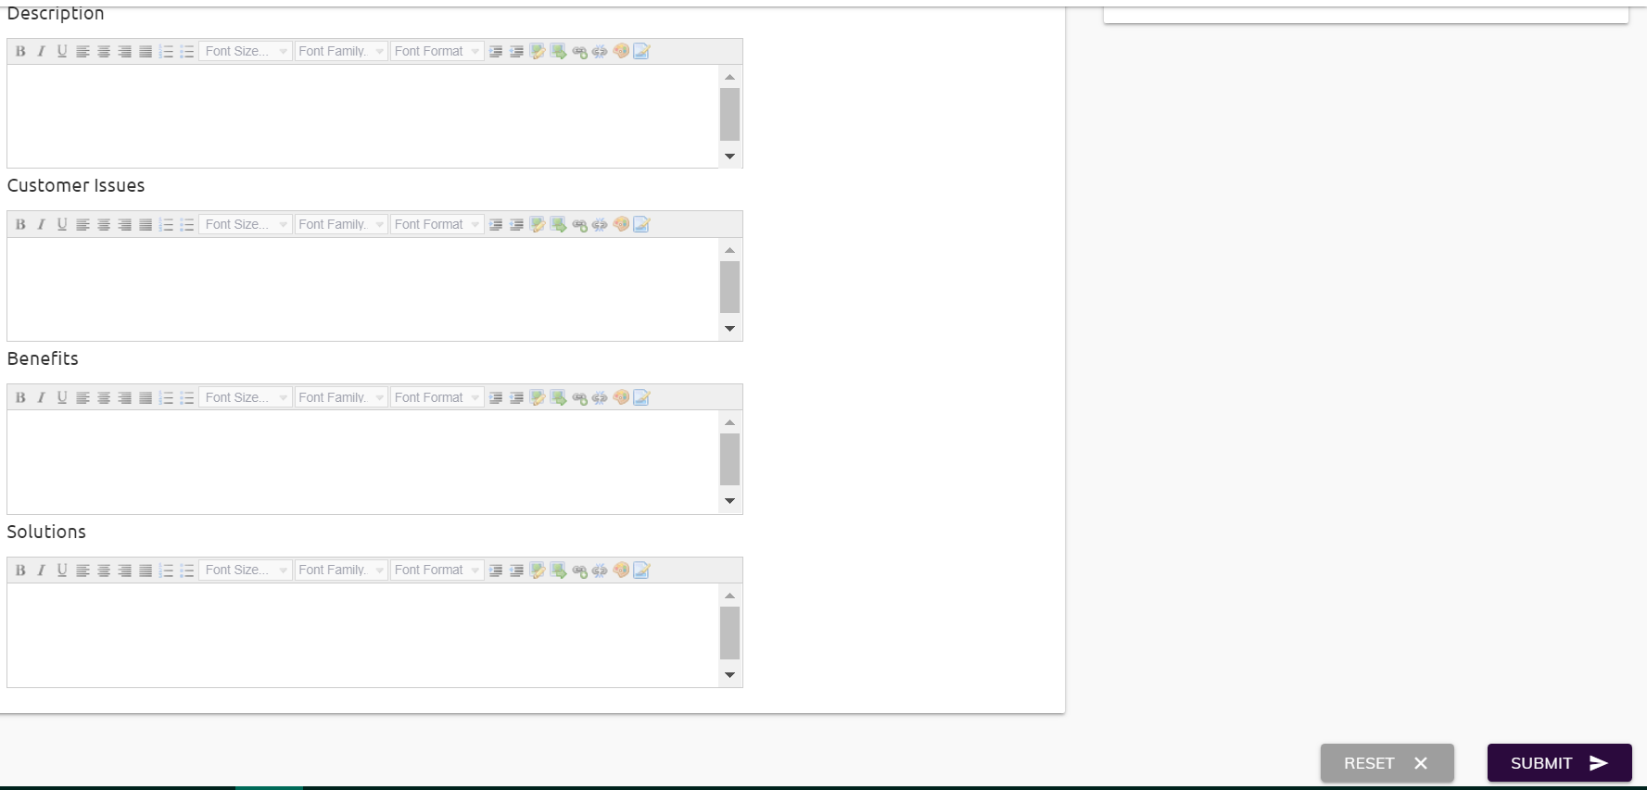
Assets Details

Slide 5
Edit Assets
Update Assets
Asset Owner
Log into Innovation Theater
Click on the User Profile (Top right corner)
Click on My Assets and then click on View Assets
Select the Asset which want to update and then click on Edit image and update Asset Details
Click on Update Button
If Rejected
AIE Board
Send for Approval
If Approved
Innovation Theater
Publish on Portal

Slide 6
Enhance Assets
Enhance and Update Assets
User / Asset Owner
End user contact Asset Owner and suggest changes / improvement
Asset Owner review the suggestion and update in the Asset wherever require
Asset Owner log into Portal and then select My Assets and then click on View Assets
Select the Asset which want to enhance and then click on Edit image and update Asset Details
Click on Update Button
If Rejected
AIE Board
Send for Approval
If Approved
Innovation Theater
Publish on Portal

Slide 7
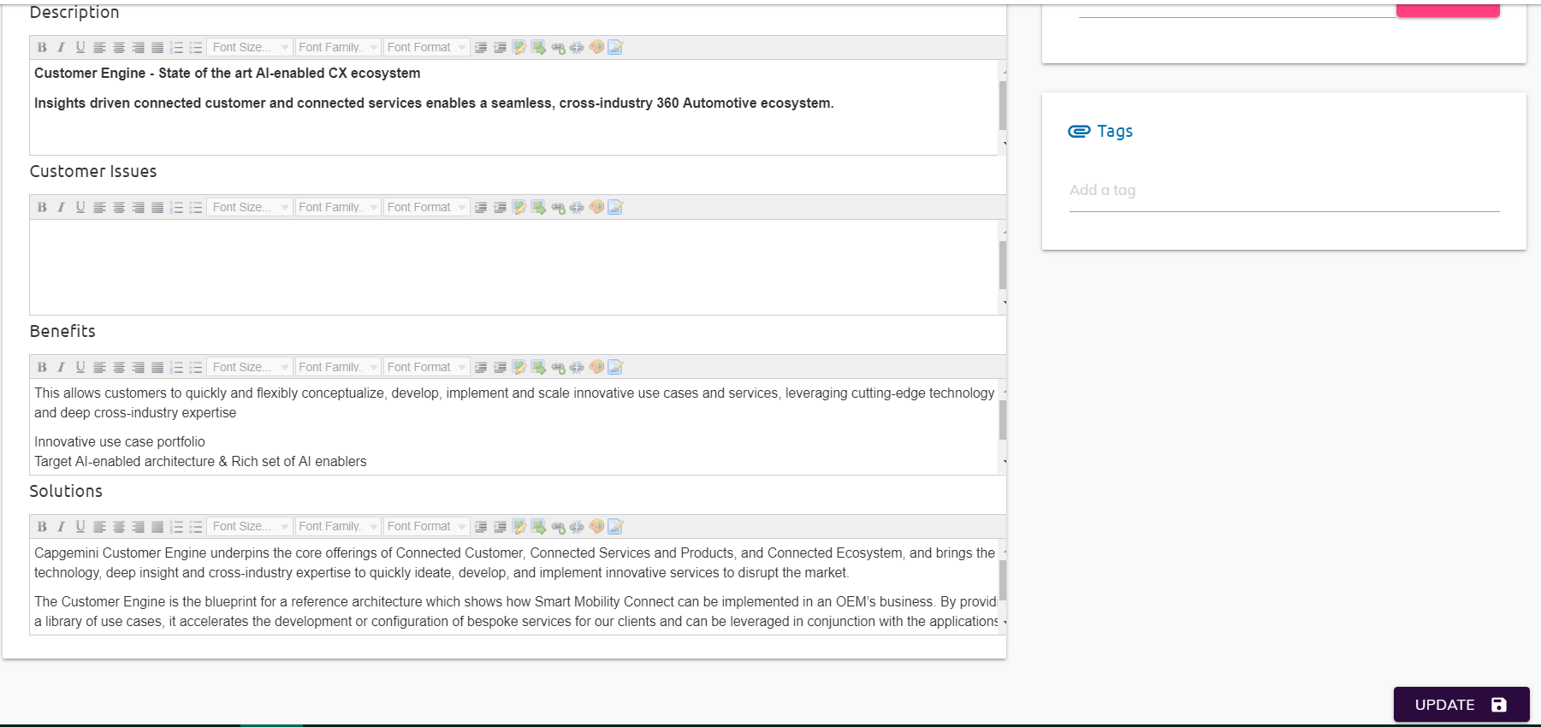
Assets Details

Slide 8
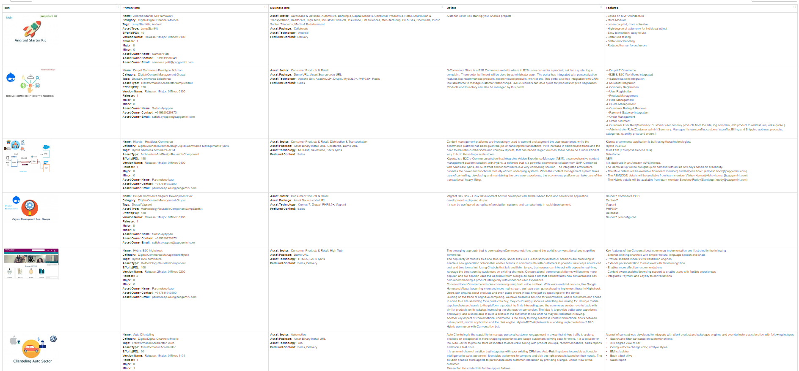
Uploading Assets from other Asset Stores
AIE Mumbai has developed a utility which help to scan POC or Innovations from respected stores and uploaded into spread sheet. The same spread sheet can be used to upload Assets into Innovation Theater through backend. Once data is verified by Asset Owners, it will be published on Innovation Theater portal.
Example of assets from DCX App Store are here -

Slide 9
Upload Assets from other Asset Store
Update Assets
Share the Utility / Crawler
Utility / Crawler uploads the Asset details into spread sheet
Using spread sheet as data.. Innovation Theater Admin upload the Asset details through backend. An email will send to Asset Owner for review
Asset Owner verifies the Asset details
Asset Store / Server
Contact Asset Store Admin
If Rejected
AIE Board
Send for Approval
If Approved
Innovation Theater
Publish on Portal

Slide 10
Bulk Upload Assets (e.g. from GitHub or similar)
Update Assets
Utility / Crawler helps to populate the Asset details into spread sheet
Using spread sheet as data.. Innovation Theater Admin upload the Asset details through backend. An email will send to Asset Owner for review
Asset Owner verifies the Asset details
Asset Store / Server
Contact Asset Store Owner
Get the bulk upload Template for their assets
If Rejected
AIE Board
Send for Approval
If Approved
Innovation Theater
Publish on Portal

Slide 11
Assets Reviewal Process (Bi Yearly)
Review Assets
AIE Board
AIE Board review all Assets. The process will be bi-yearly
Shortlist the Assets which are dated
AIE Board will send email to Asset Owner for confirmation
Send for Confirmation
Asset will publish on Portal upon approval
If Reject
Asset Owner update Asset and send for approval
Asset Owner
If Confirm
Innovation Theater
Remove / Retire on Portal

